Slide 1


DATA STRUCTURES AND ALGORITHMS
Heaps
CCE 105
Data Structures
Prepared by:

Slide 2

01
Heaps

Slide 3
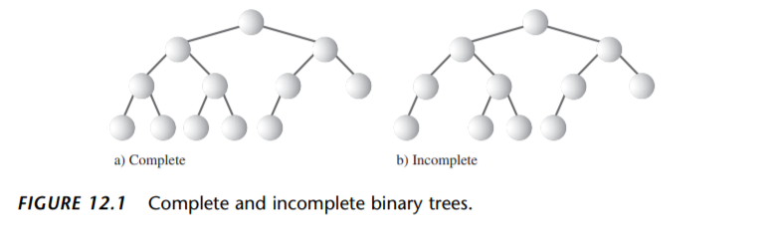

A heap is a binary tree with these characteristics: - It’s complete. This means it’s completely filled in, reading from left to right across each row, although the last row need not be full. - It’s (usually) implemented as an array. - Each node in a heap satisfies the heap condition, which states that every node’s key is larger/smaller than the keys of its children.
Heaps

Slide 4
Heaps are mostly used to implement priority queues. However, there’s a very close relationship between a priority queue and the heap used to implement it. Maxheap: key(v) <= key(parent(v)) Minheap: key(v) >= key(parent(v))
Heaps

Slide 5
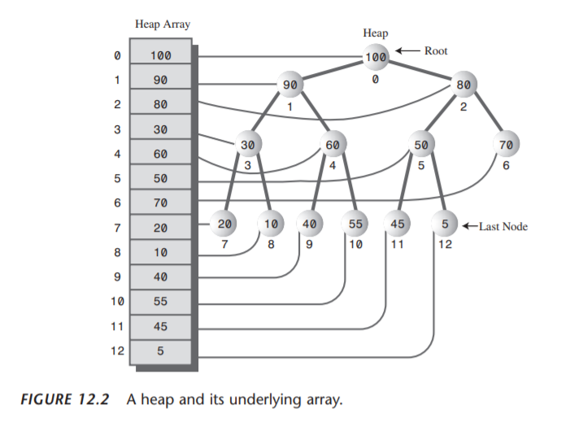
Heaps

Slide 6
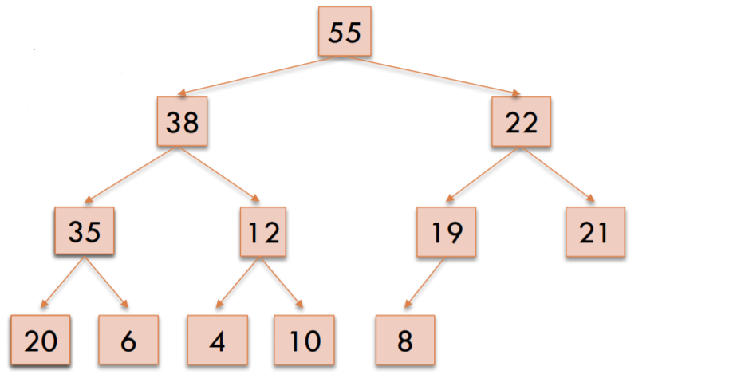
Completeness Property
Heaps
Every level (except last)
completely filled.
Nodes on bottom level are
as far left as possible.

Slide 7
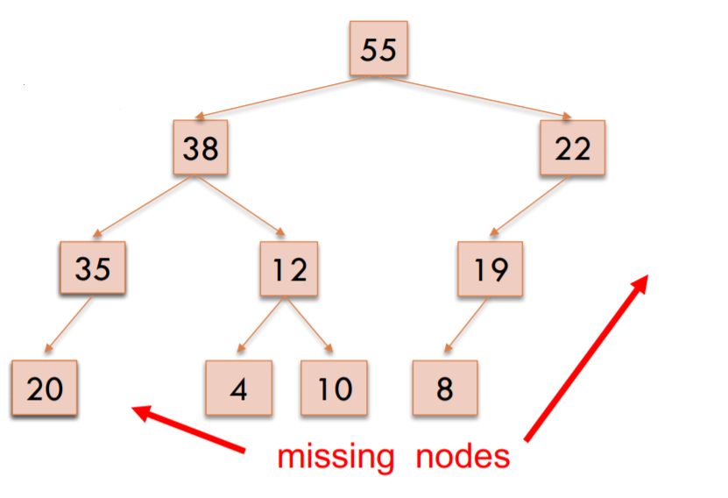
Completeness Property
Heaps
Not a heap because:
• missing a node on level 2
• bottom level nodes are
not as far left as possible

Slide 8
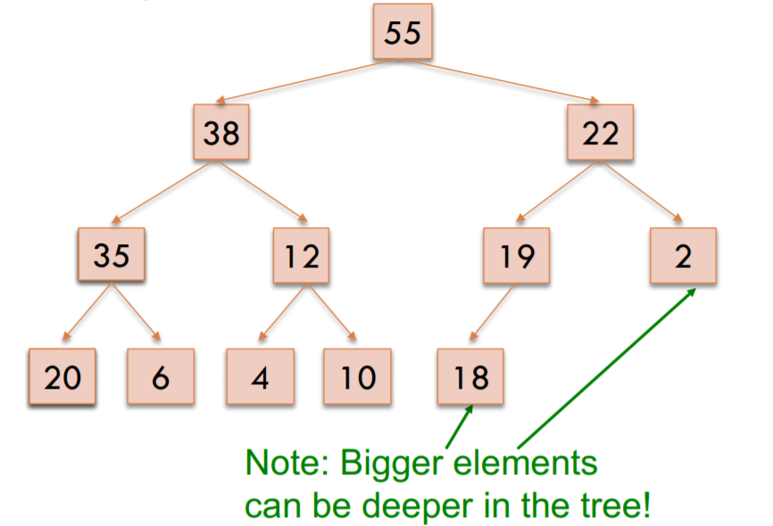
Order Property
Heaps
Every element is <= its parent

Slide 9
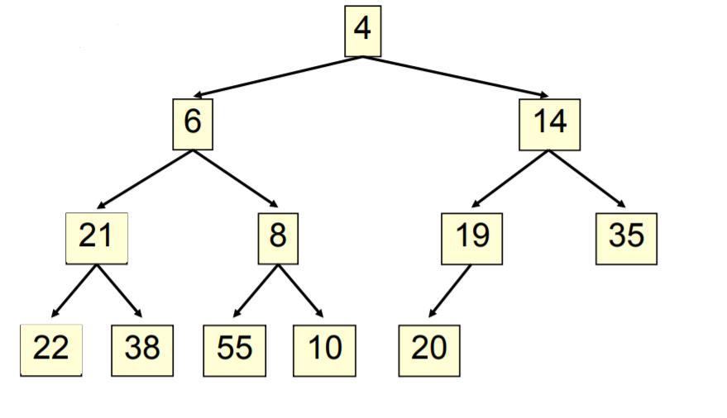
Order Property
Heaps
Every element is >= its parent

Slide 10
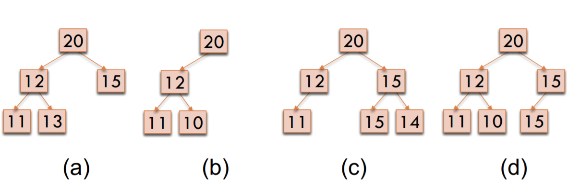
Order Property
Heaps
Which of the following are valid heaps?

Slide 11
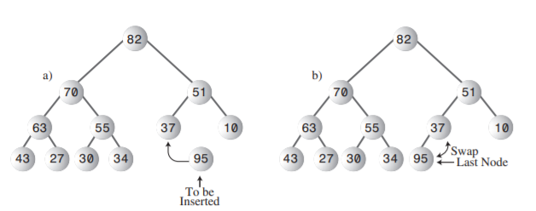
Insertion
Heaps
Inserting a node is also easy. Insertion uses trickle up, rather than trickle down.
Initially, the node to be inserted is placed in the first open position at the end of the array, increasing the array size by one

Slide 12
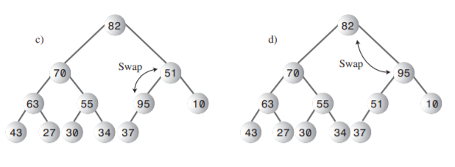
Insertion
Heaps
Inserting a node is also easy. Insertion uses trickle up, rather than trickle down.
Initially, the node to be inserted is placed in the first open position at the end of the array, increasing the array size by one

Slide 13
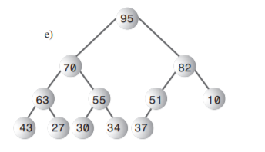
Insertion
Heaps
Inserting a node is also easy. Insertion uses trickle up, rather than trickle down.
Initially, the node to be inserted is placed in the first open position at the end of the array, increasing the array size by one

Slide 14
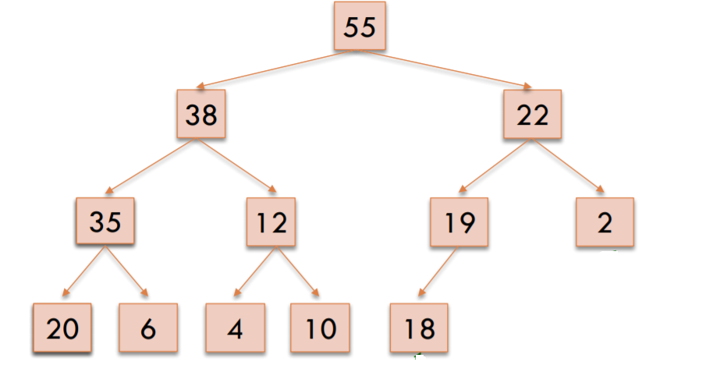
Insertion Maxheap
Heaps
Let’s try inserting 50

Slide 15
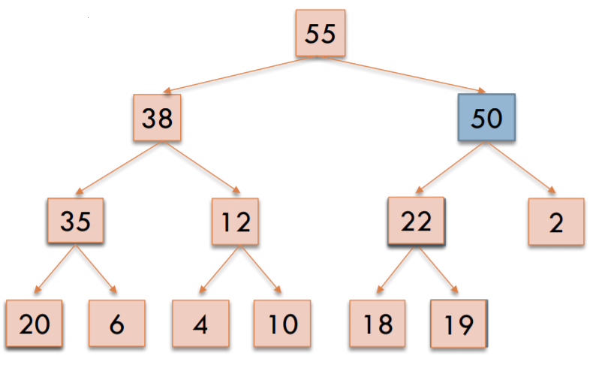
Insertion Maxheap
Heaps
Let’s try inserting 50

Slide 16
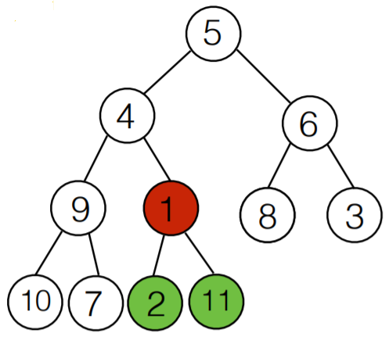
Insertion Minheap
Heaps
Insert the following elements:
5 4 6 9 1 8 3 10 7 2 11

Slide 17
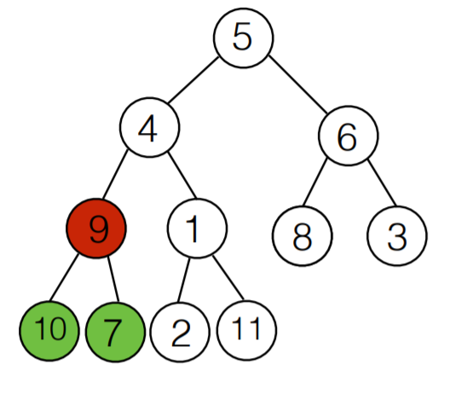
Insertion Minheap
Heaps
Insert the following elements:
5 4 6 9 1 8 3 10 7 2 11

Slide 18
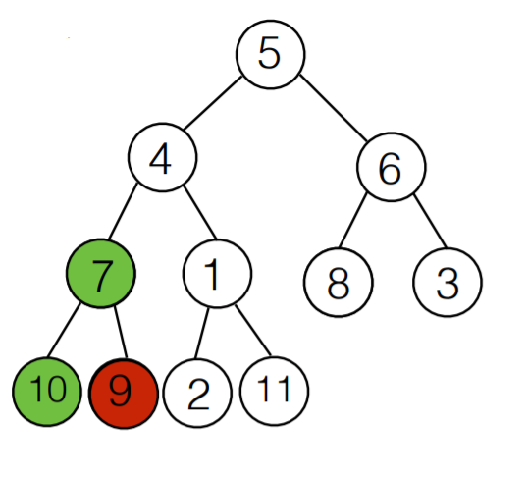
Insertion Minheap
Heaps
Insert the following elements:
5 4 6 9 1 8 3 10 7 2 11

Slide 19
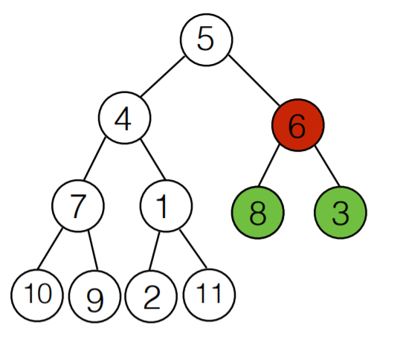
Insertion Minheap
Heaps
Insert the following elements:
5 4 6 9 1 8 3 10 7 2 11

Slide 20
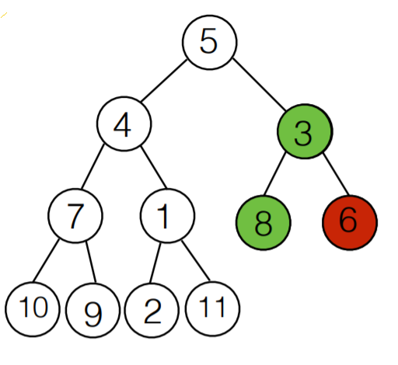
Insertion Minheap
Heaps
Insert the following elements:
5 4 6 9 1 8 3 10 7 2 11

Slide 21
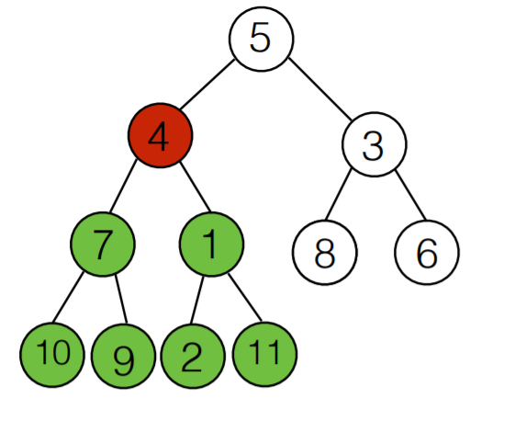
Insertion Minheap
Heaps
Insert the following elements:
5 4 6 9 1 8 3 10 7 2 11

Slide 22
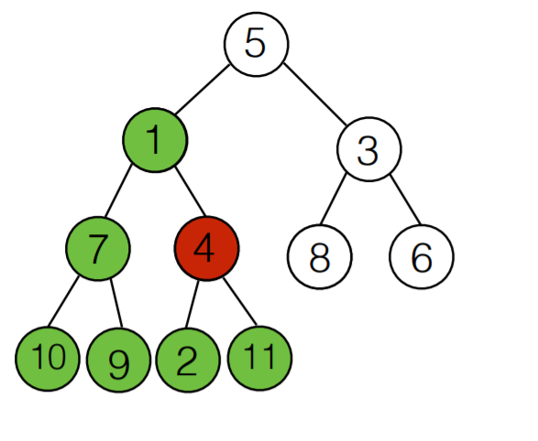
Insertion Minheap
Heaps
Insert the following elements:
5 4 6 9 1 8 3 10 7 2 11

Slide 23
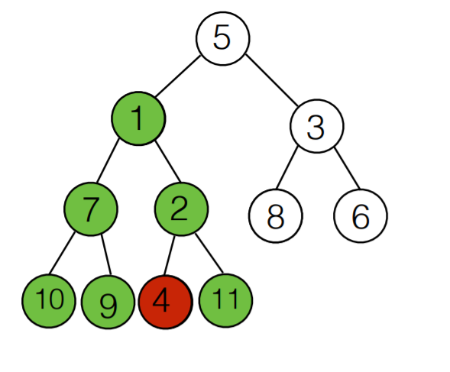
Insertion Minheap
Heaps
Insert the following elements:
5 4 6 9 1 8 3 10 7 2 11

Slide 24
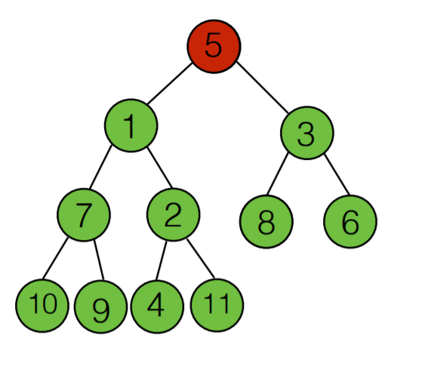
Insertion Minheap
Heaps
Insert the following elements:
5 4 6 9 1 8 3 10 7 2 11

Slide 25
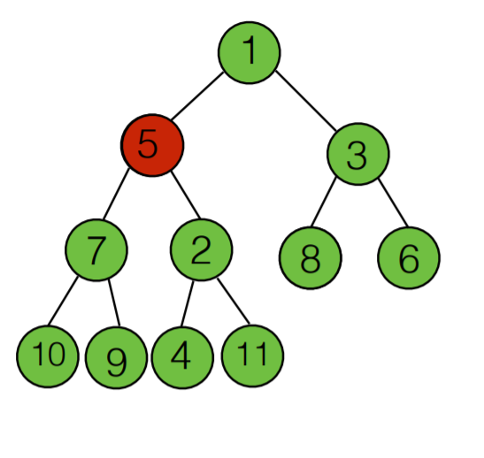
Insertion Minheap
Heaps
Insert the following elements:
5 4 6 9 1 8 3 10 7 2 11

Slide 26
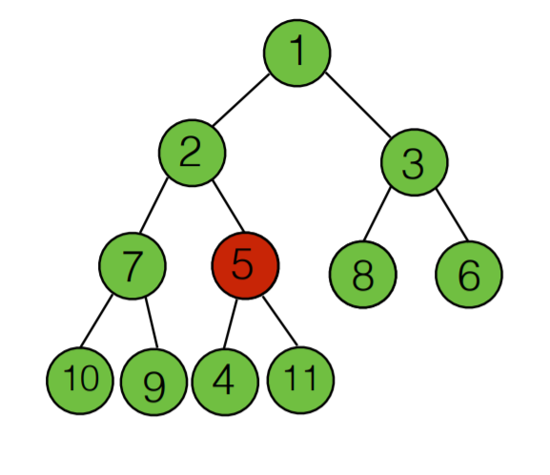
Insertion Minheap
Heaps
Insert the following elements:
5 4 6 9 1 8 3 10 7 2 11

Slide 27
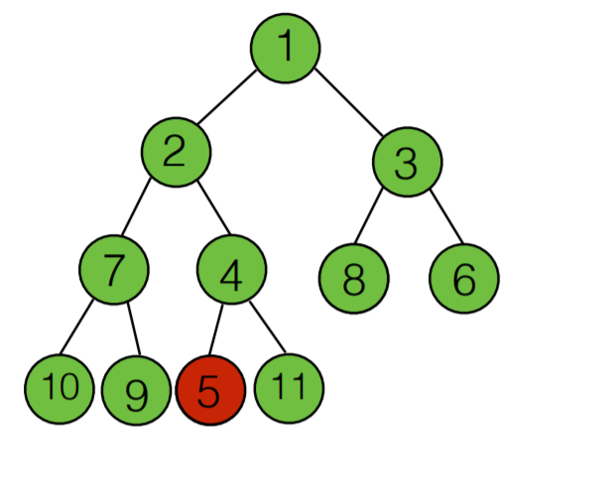
Insertion Minheap
Heaps
Insert the following elements:
5 4 6 9 1 8 3 10 7 2 11

Slide 28
Removal
Heaps
Removal means removing the node with the maximum/minimum key. This node is always the root, so removing it is easy. The root is always at index 0 of the heap array.
maxNode = heapArray[0];
The problem is that once the root is gone, the tree is no longer complete; there’s an empty cell. This “hole” must be filled in. We could shift all the elements in the array down one cell, but there’s a much faster approach.

Slide 29
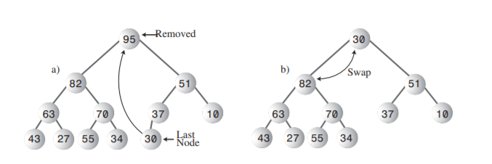
Removal
Heaps
Here are the steps for removing the maximum node:
Remove the root.
Move the last node into the root.
Trickle the last node down until it’s below a larger node and above a smaller one.

Slide 30
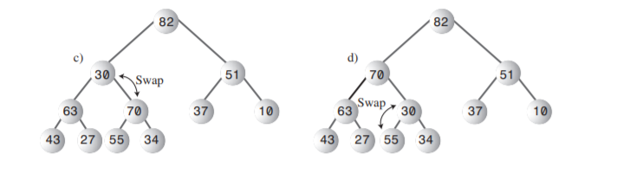
Removal
Heaps
Here are the steps for removing the maximum node:
Remove the root.
Move the last node into the root.
Trickle the last node down until it’s below a larger node and above a smaller one.

Slide 31
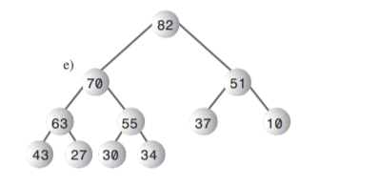
Removal
Heaps
Here are the steps for removing the maximum node:
Remove the root.
Move the last node into the root.
Trickle the last node down until it’s below a larger node and above a smaller one.

Slide 32
Removal
Heaps
Let’s try deleting 55

Slide 33
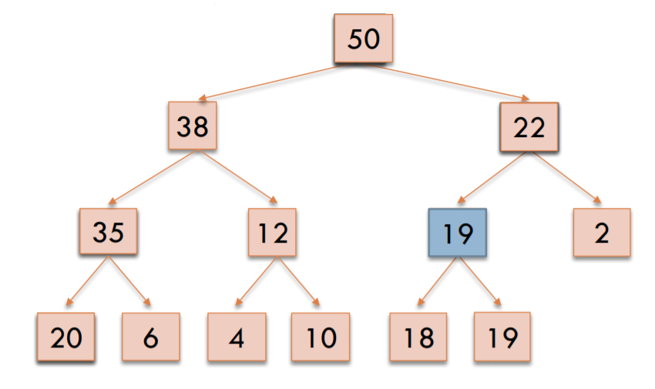
Removal
Heaps
Let’s try deleting 55

Slide 34
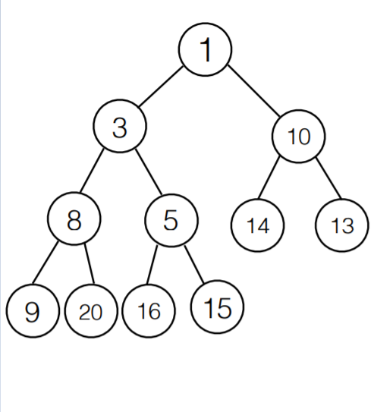
Removal
Heaps
Let’s try deleting 1

Slide 35
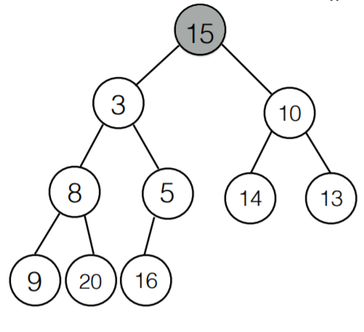
Removal
Heaps
Let’s try deleting 1

Slide 36
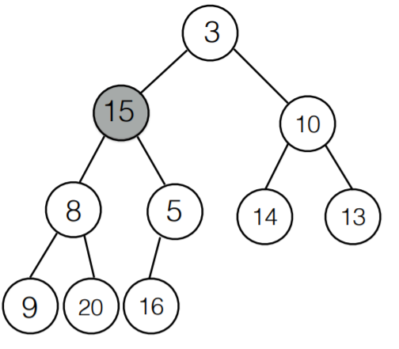
Removal
Heaps
Let’s try deleting 1

Slide 37
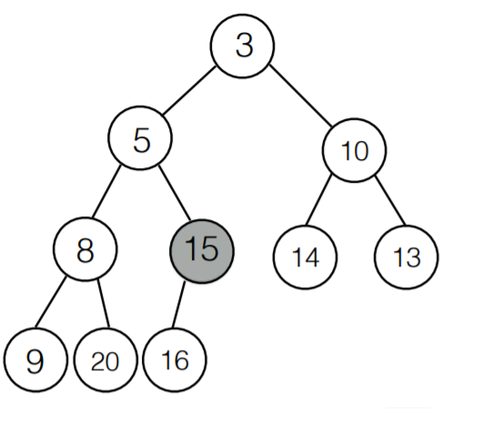
Removal
Heaps
Let’s try deleting 1

Slide 38
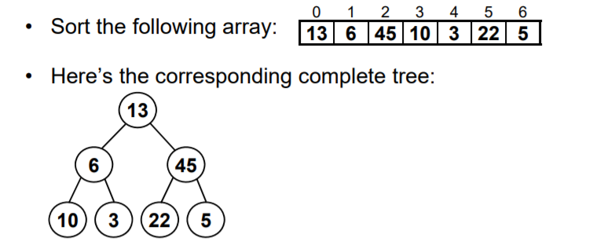
Heapsort
Heaps

Slide 39
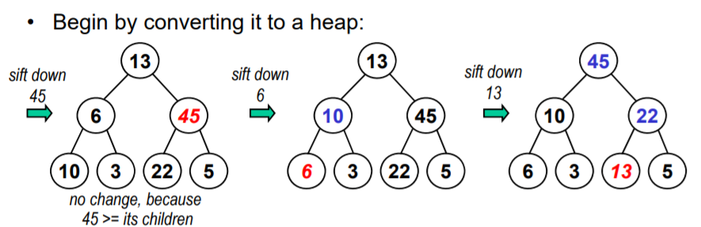
Heapsort
Heaps

Slide 40
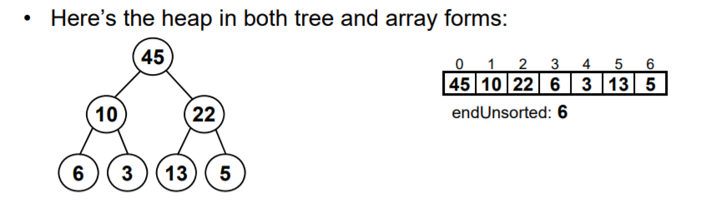
Heapsort
Heaps

Slide 41
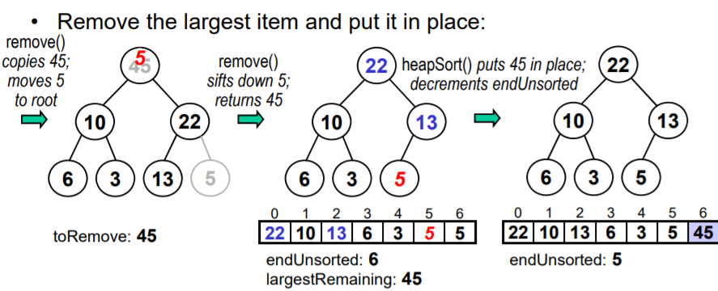
Heapsort
Heaps

Slide 42
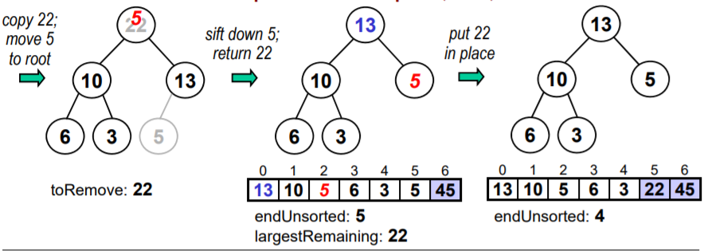
Heapsort
Heaps

Slide 43
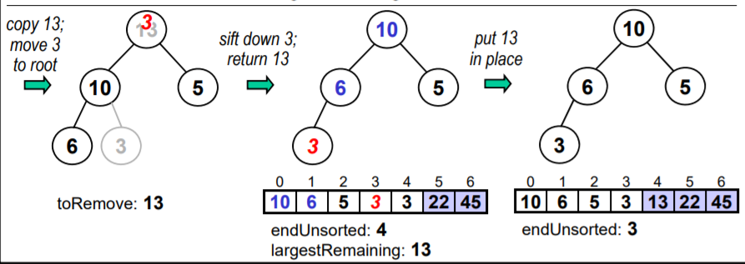
Heapsort
Heaps

Slide 44
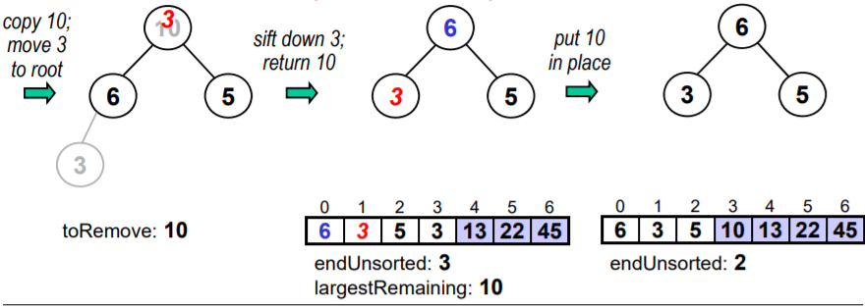
Heapsort
Heaps

Slide 45
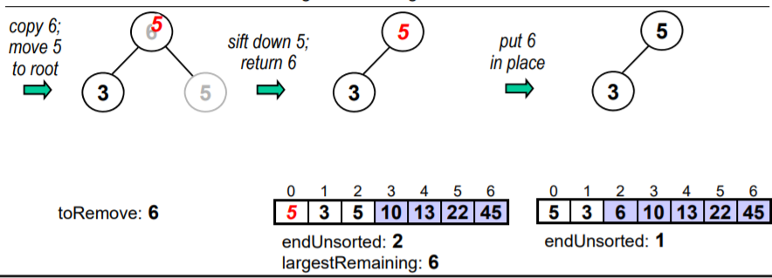
Heapsort
Heaps

Slide 46
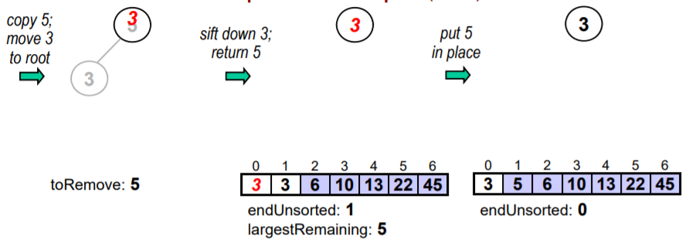
Heapsort
Heaps

Slide 47
Heaps
Let us try!
35 33 42 10 14 19 27 44 26 31
1. Create a heap tree.
2. Create a Maxheap.
3. Delete the largest element in Maxheap.
4. Sort using heapsort (maxheap).

